Slide 4




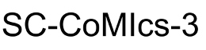
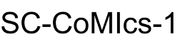
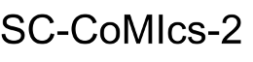



Entity Recognition
Entity
Extraction
100
80
60
40
20
v
Classification

Slide 5
100
80
60
40
20
v

